Slide 1

MAJOR PROJECT STAGE-II PRESENTATION ON FAKE NEWS DETECTION
SUBMITTED BY
Adarsh Kumar jha
Rajiv kumar giri
Debabrata bar
Gulam samdani nizami
Under the guidance of
Dr. Sukant K. Bisoyi

Slide 2

Content
Motivation
Problem Statement
Data set
Literature Survey
Requirements
Workflow
Data Pre-processing
Feature Selection
Classifier
Prediction
Fake News Detector App
Conclusion
Future Work
References

Slide 3
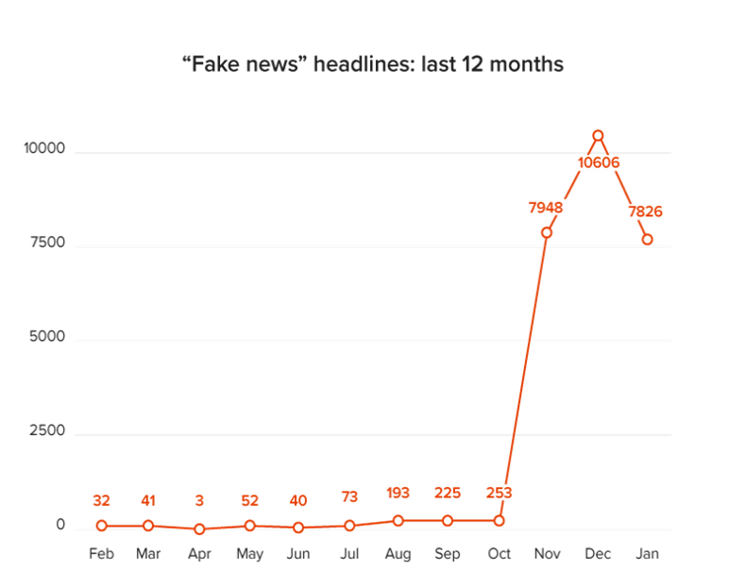
Motivation
Prevalence of Fake News on Social Media
Emerging Research area in natural language processing
Basic countermeasures inflexible and inefficient
Current progress in this area

Slide 4

Problem Statement
Develop a Machine Learning Model to identify fake/unreliable news based on content acquired

Slide 5
Literature Survey
The authors in Analysis of Classifiers for Fake News Detection discusses the approach of natural language processing and machine learning in order to solve fake news detection . Use of bag-of-words, n-grams, count vectorizer has been made, TF-IDF, and trained the data on five classifiers to investigate which of them works well for this specific dataset of labelled news statements. The precision, recall and f1 scores help us determine which model works best.
The authors in Fake News Detection Using A Deep Neural Network used various models to access deceptive news in social media. Their contribution is bifold. First, they introduce the datasets which contain both fake and real news and conduct various experiments to organize fake news detector. They use Natural Language Processing, Machine learning and deep learning techniques to classify the datasets. They did a comprehensive audit of detecting fake news by including fake news categorization, existing algorithms from machine learning techniques.

Slide 6
Authors in Merging deep learning model for fake news detection suggested a merged deep learning model that detect fake articles regarding different characteristics. Therefore, Authors used word embedding technique and convolutional neural network to extract text-based features and compare different architecture of deep learning while merging two CNNs with different metadata (Text, title, and author). Term Frequency-Inverted Document Frequency (TF-IDF) was used as feature extraction technique. They show on real dataset that the proposed approach is very efficient and allows to achieve high performances. Their proposed model uses Linear Support Vector Machine (LSVM) and n-gram analysis achieving an accuracy of 92%.
The Authors in Detecting Fake News on Social Media: A Multi-Source Scoring Framework proposed FNDMS, a framework that integrates the credibility scores of multiple news sources to detect fake news. FNDMS uses two sets of features, i.e., author-based features and content-based features, to measure the credibility of a single news source. Then a DST model is employed to integrate credibility’s of multiple sources and produce a judgment on the truth of an event. To collect event-related reports, they also propose a three-step method to retrieve and filter news articles from social media sites in this research paper. Experimental results on real social media data demonstrate the feasibility and advance of FNDMS

Slide 7
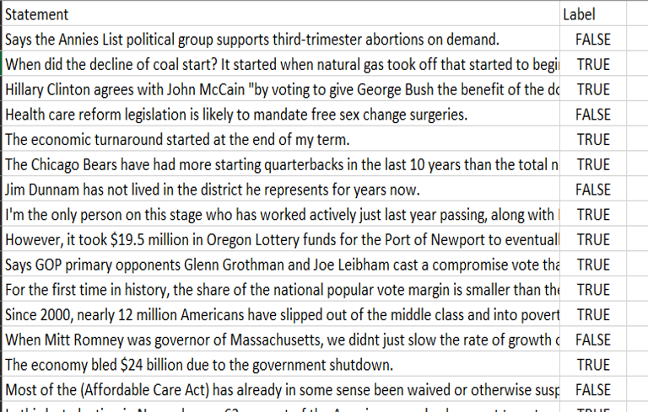
Dataset
Previous Semester
Dataset Source – Liar Dataset
Column : Statement , Label
True : Reliable
False : Unreliable

Slide 8
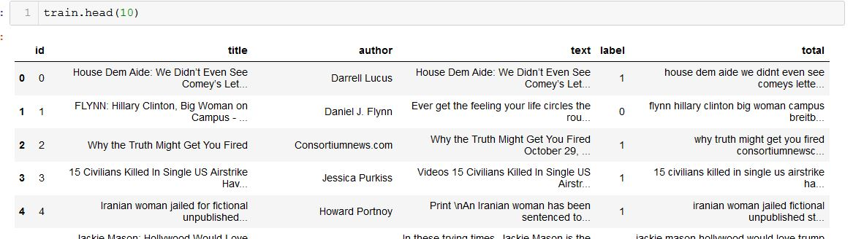
Dataset
This Semester
Dataset Source – News Article Dataset
Column : Title, author, text, label
1 : Reliable or True News
0 : Unreliable or Fake News

Slide 9




Requirements
Software Requirements:
Operating System : Windows XP/7/8/10, Linux , MacOS
IDE : Jupyter Notebook
Scripted Language : Python
Libraries : NumPy, pandas . Scikit learn.
Hardware Requirements:
Processor : Intel Core 2.0 GHz or more
RAM : 512 MB or more
Hard Disk : 10GB or more

Slide 10
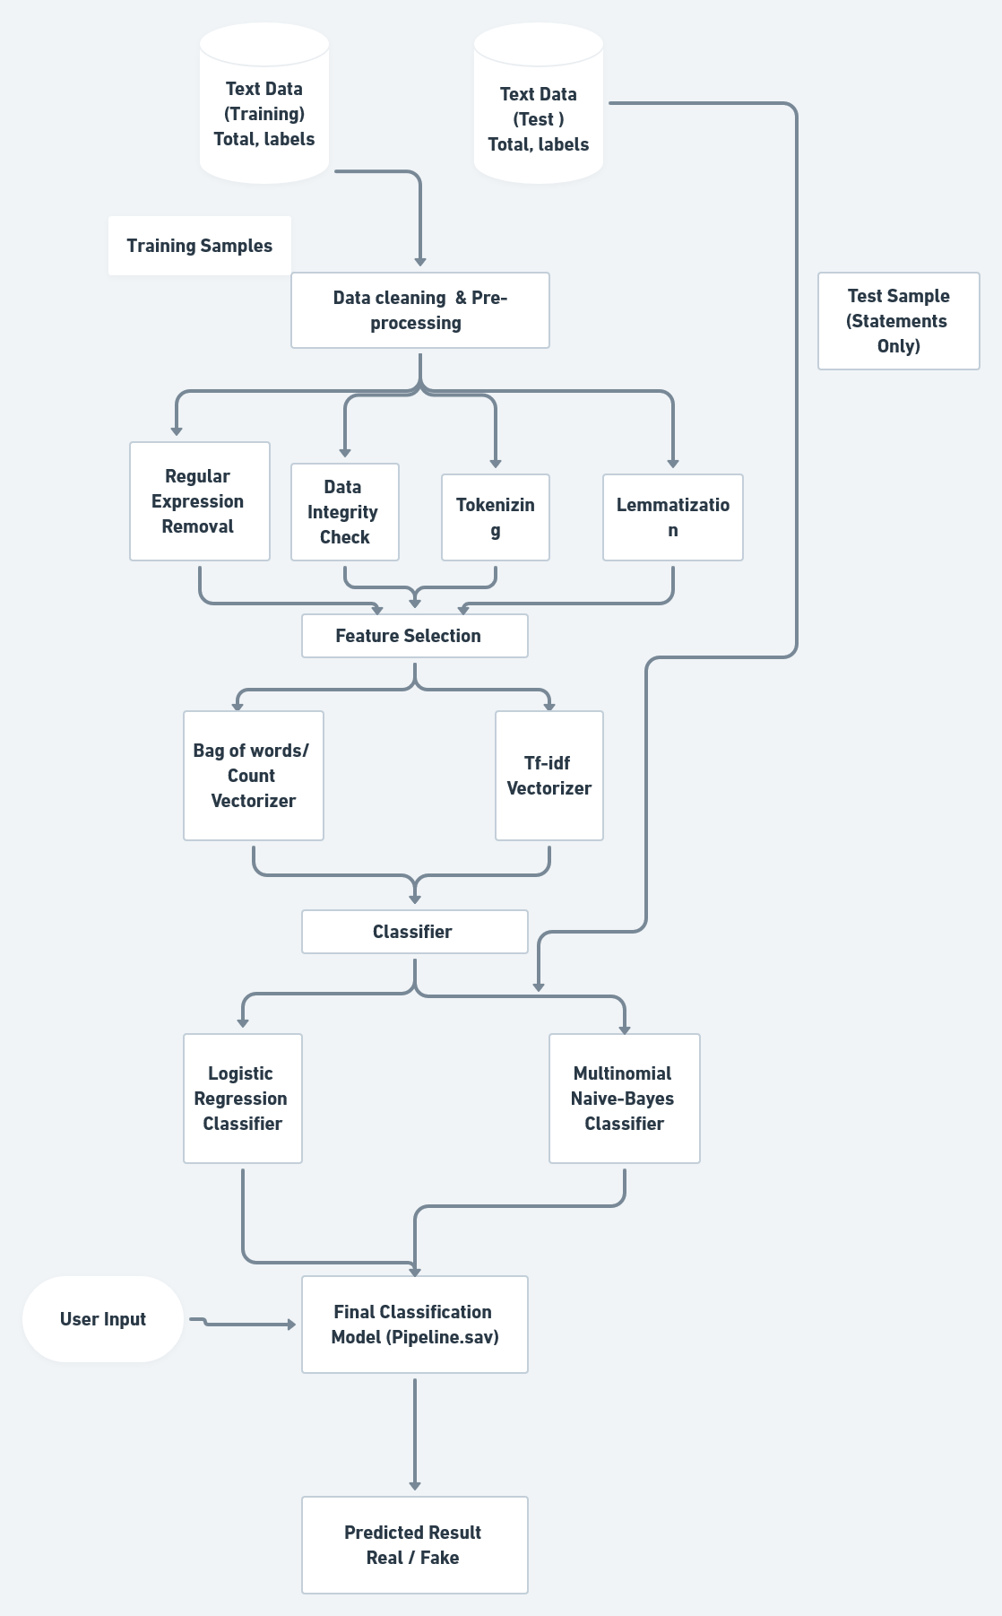
Workflow
Data Pre-processing
Feature Selection
Classifier Selection
Final Classification Model
Prediction

Slide 11
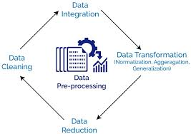
1. Cleaning & Data Pre-processing
Data preprocessing involves the transformation of the raw dataset into an understandable format.
Preprocessing data is a fundamental stage in data mining to improve data efficiency.
The data preprocessing methods directly affect the outcomes of any analytic algorithm.

Slide 12
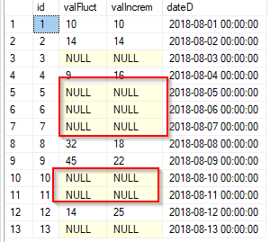
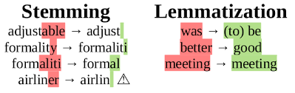
Previous Semester
Following Are Performed Various Text Cleaning Steps :
Data Distribution : First We Have To Distribute The Dataset In Train And Test Data
Data Integrity Check: Delete All Type Of Missing Rows , Or Null Value From Dataset.
Stemming : Then We Reduced Words In Its Stem Or Root Word By Removing Inflection Through Dropping Unnecessary Characters, Usually A Suffix.
Tokenizing : Then We Tokenize Or Spitting All The Words Or Strings Into A List Of Tokens , Like A Word Is A Token In A Sentence Or A Sentence Is A Token In Paragraph
Data Integrity Check
Stemming

Slide 13
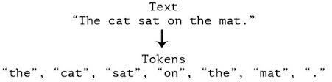
In this Semester ,we have used below mentioned Pre-processing techniques ;
This Semester
Regular Expression Removal : First we have remove all the regular expression from our data set .
Data Integrity check: we Deleted all type of missing rows , or null value from dataset.
Tokenizing : then we tokenize or spitting all the words or strings into a list of tokens , like a word is a token in a sentence or a sentence is a token in paragraph
Lemmatization : Then we reduced all words in their dictionary format which is lemmatization.
Tokenizing
Lemmatization

Slide 14
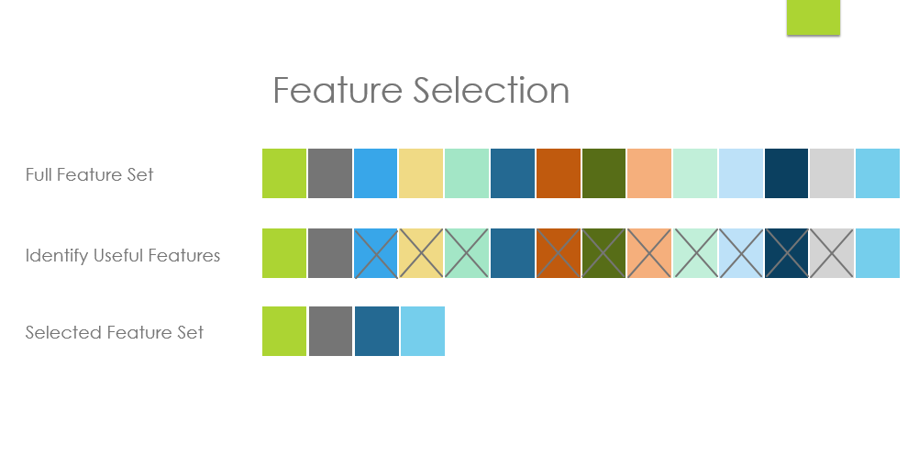
2. Feature Selection
Feature importance refers to a class of techniques for assigning scores to input features to a predictive model that indicates the relative importance of each feature when making a prediction.

Slide 15
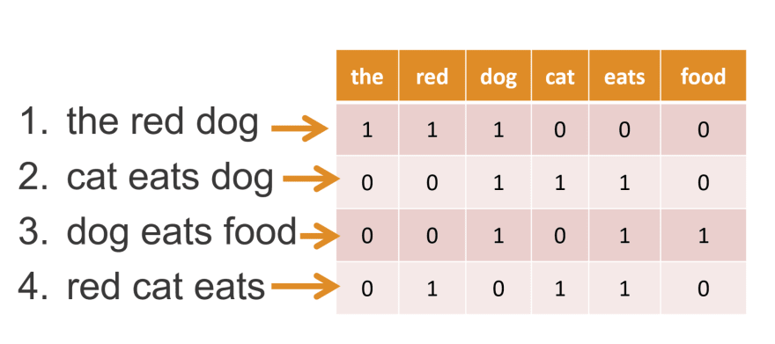
This semester we have used below listed Techniques for extraction of features:
Bag of Words : This technique used to preprocess the text by converting it into a bag of words, which keeps a count of the total occurrences of most frequently used words.
n-grams : In this Process we basically check how many words in a sentence , it is very simple and scalable for NLP
Term Frequency (Tf-Idf): Term frequency shows how frequently an expression occurs in document , it also indicate the significance of particular term in the whole document
Bag of words/Count Vectorizer

Slide 16
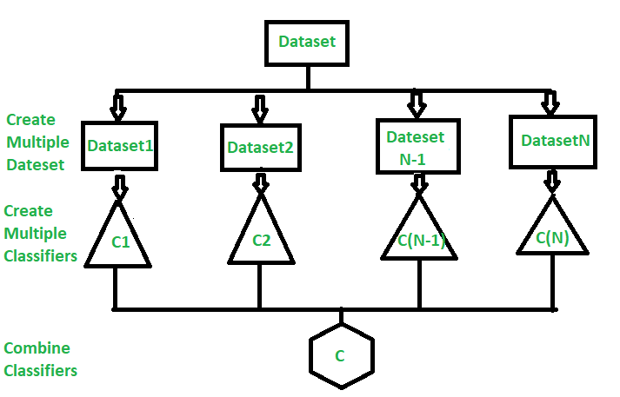
3. Classifier Selection
Classifier is a hypothesis or discrete-valued function that is used to assign (categorical) class labels to particular data points.We used two classifier and select final classifier model based on their accuracy.

Slide 17
In previous semester we have constructed below listed classifiers:
Previous Semester
Naive –bayes Classier
Logistic Regression Classifier
Linear SVM
Random Forest Classifier
Stochastic Gradient Descent Classifier

Slide 18
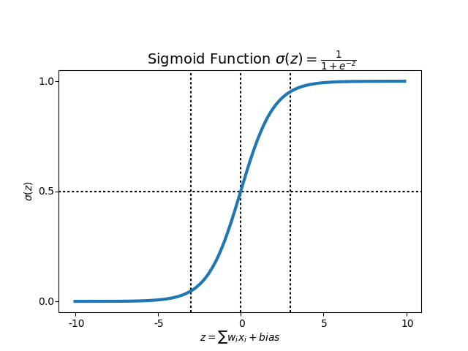
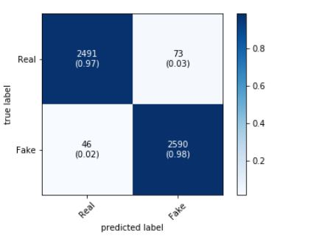
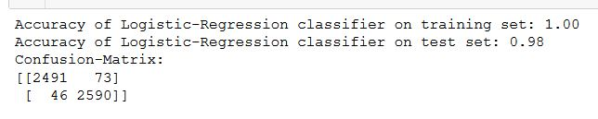
Logistic-Regression Classifier
This Semester
It is one of the most popular machine learning algorithms
It gives the probabilistic value which lies between 0 and 1
In this algorithm we fit an “S” shaped logistic function
Sigmoid function graph
LR Confusion - Array
Confusion Matrix

Slide 19
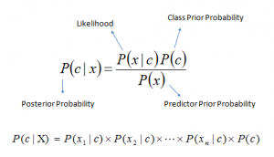
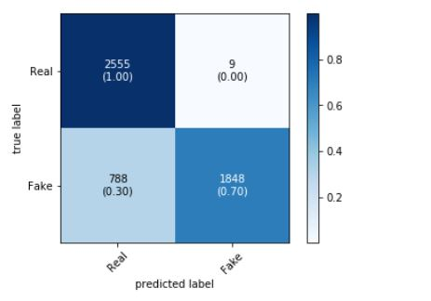
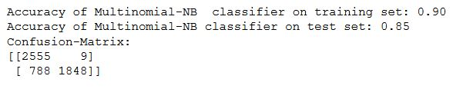
Multinominal Naive-bayes Classifier
This Semester
Multinomial Naive Bayes is a specialized version of Naive Bayes that is designed more for text documents .
The multinomial Naive Bayes classifier is suitable for classification with discrete features
multinomial naive bayes explicitly models the word counts and adjusts the underlying calculations to deal with in.
Naive Bayes theorem
Multinominal NB Confusion - Array
Confusion Matrix

Slide 20
Comparison of Models
Previous Semester
Classifiers | Accuracy
1. Naive bayes Model | 70.24%
2. Logistic Regression | 72.44%
3. Linear SVM | 67.90%
4.Random Forest Classifier | 71.90%
5. Stochastic Gradient Descent | 66.06%

Slide 21
Comparison of Models
This Semester
Classifiers | Accuracy
1. Logistic Regression | 98%
2. Multinominal Naive bayes | 85%

Slide 22


Prediction
As a final Classification Model for prediction the output we have used the Logistic Regression Classification model as its Accuracy is better than all of those classification model
We have develop a web based app for user who wants to check a news is fake or real.

Slide 23
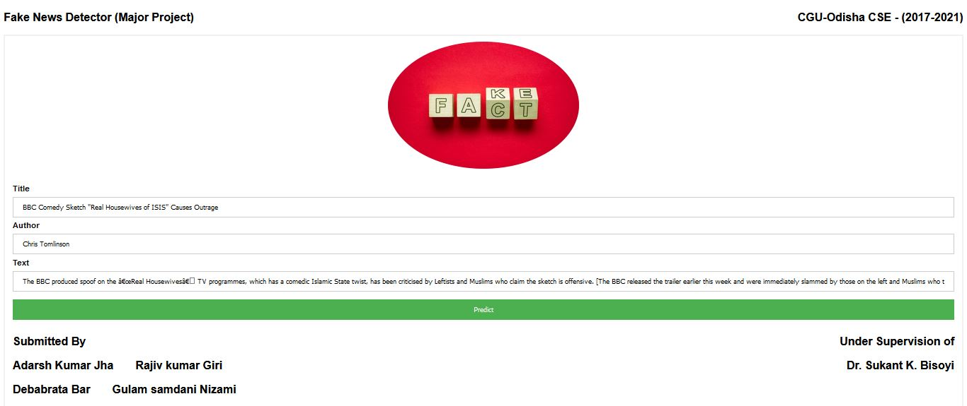
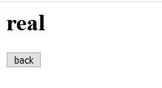
Fake News Detector Web app

Slide 24
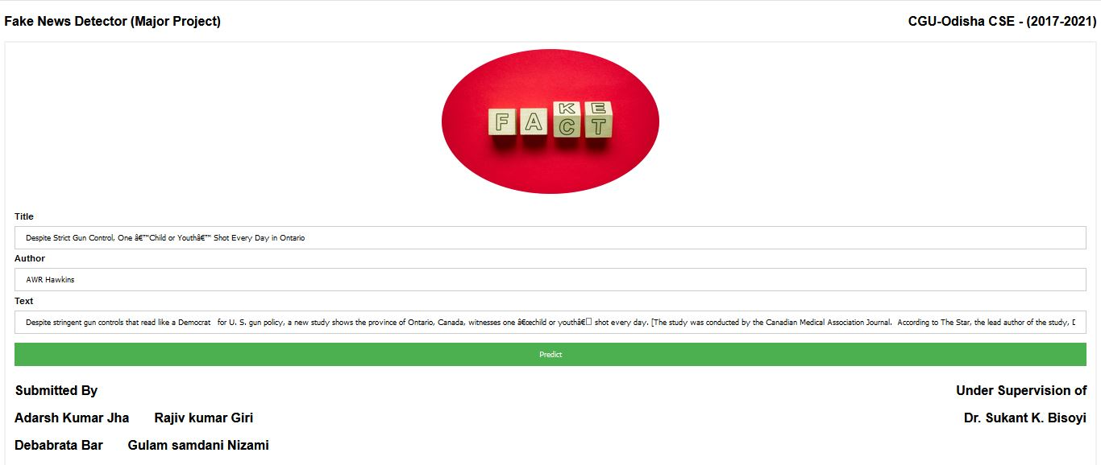
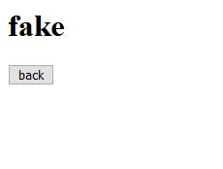
Fake News Detector Web app

Slide 25

Conclusion
Fake news is a phenomenon which is having a significant impact on our social life, in particular in the political world. just like in the last US presidential elections.
We have used two different classifiers that are Logistic Regression, Multinominal Naïve bayes .Finally, based on the accuracy and performance the selected classifier for detection is Logistic Regression Classifier .
We achieved classification accuracy of approximately 98% on the test set which is a decent result considering the relative simplicity of the model.
This way we can help people make more informed decisions and they will not be fooled into thinking what others want to manipulate them into believing.

Slide 26

Future Work
Apply deep learning techniques for better result
Increase number of features to get more perfect Result
Increases the processing speed
Quality of the Dataset can be improved

Slide 27
References
Vasu Agarwala, H. Parveen Sultana, Srijan Malhotra, Amitrajit Sarkar , "Analysis of Classifiers for Fake News Detection", Procedia Computer Science , Volume 165, 2019, Pages 377-383, doi : 10.1016/j.procs.2020.01.035.
R. K. Kaliyar, "Fake News Detection Using A Deep Neural Network," 2018 4th International Conference on Computing Communication and Automation (ICCCA), Greater Noida, India, 2018, pp. 1-7, doi: 10.1109/CCAA.2018.8777343.
B. M. Amine, A. Drif and S. Giordano, "Merging deep learning model for fake news detection," 2019 International Conference on Advanced Electrical Engineering (ICAEE), Algiers, Algeria, 2019, pp. 1-4, doi: 10.1109/ICAEE47123.2019.9015097.
H. Liu, L. Wang, X. Han, W. Zhang and X. He, "Detecting Fake News on Social Media: A Multi-Source Scoring Framework," 2020 IEEE 5th International Conference on Cloud Computing and Big Data Analytics (ICCCBDA), Chengdu, China, 2020, pp. 524-531, doi: 10.1109/ICCCBDA49378.2020.9095586.
Monther Aldwairi, Ali Alwahedi. Detecting Fake News in Social Media Networks. In The 9th International Conference on Emerging Ubiquitous Systems and Pervasive Networks (EUSPN 2018), At Leuven, Belgium, Volume: 141.
Chaowei Zhang, Ashish Gupta, Christian Kauten, Amit V. Deokar, Xiao Qin. Detecting fake news for reducing misinformation risks using analytics approaches. Elsevier European Journal of Operational Research, 2019, Volume 279, Issue 3, 16 December 2019, Pages 1036-1052.
Sarah A. Alkhodair, Steven H.H. Ding, Benjamin C.M. Fung, Junqiang Liu. Detecting breaking news rumours of emerging topics in social media. Elsevier Information Processing and Management,2019, Volume 57, Issue 2, March 2020, 102018.
Pritika Bahad, Preeti Saxena, Raj Kamal. Fake News Detection using Bi-directional LSTM-Recurrent Neural Network. In IEEE, 2019 International Conference on Recent Trends in Advanced Computing (ICRTAC), Procedia Computer Science 165 (2019) 74–82.
B. M. Amine, A. Drif and S. Giordano, "Merging deep learning model for fake news detection," 2019 International Conference on Advanced Electrical Engineering (ICAEE), Algiers, Algeria, 2019, pp. 1-4, doi: 10.1109/ICAEE47123.2019.9015097.
H. Liu, L. Wang, X. Han, W. Zhang and X. He, "Detecting Fake News on Social Media: A Multi-Source Scoring Framework," 2020 IEEE 5th International Conference on Cloud Computing and Big Data Analytics (ICCCBDA), Chengdu, China, 2020, pp. 524-531, doi: 10.1109/ICCCBDA49378.2020.9095586.

Slide 28
https://jupyter.org/install
https://www.anaconda.com/products/team
https://docs.python.org/3/
https://www.geeksforgeeks.org/machine-learning/
http://deeplearning.net/tutorial/gettingstarted.html
https://www.analyticsvidhya.com/blog/2017/09/naive-bayes-explained/
https://www.tutorialspoint.com/python_pandas/index.htm
https://www.tutorialspoint.com/machine_learning_with_python/machine_learning_with_python_classification_algorithms_random_forest.htm
https://scikit-learn.org/stable/
https://sites.cs.ucsb.edu/~william/data/liar_dataset.zip
https://towardsdatascience.com/logistic-regression-classifier-8583e0c3cf9
https://www.analyticsvidhya.com/blog/2017/09/understaing-support-vector-machine-example-code/
https://www.tutorialspoint.com/machine_learning_with_python/machine_learning_with_python_classification_algorithms_random_forest.htm
https://scikit-learn.org/stable/modules/sgd.html

Slide 29


